Slide 1
Anti epileptic drugs

Slide 2
Mechanisms of action
Membrane stabilization
Interferes with transmission of seizure activity through inhibitory neurotransmitter GABA

Slide 3
Phenobarbitone
enhances GABA function
Used in tonic clonic epilepsy
Used in the prophylaxis of febrile convulsions.

Slide 4
Hydantoins: phenytoin
Membrane stabilizer
Prevents the initiation and the spread of repetitive neuronal discharges
Well absorbed orally
90% bound to plasma albumin
Shows saturation kinetics
Is a potent hepatic enzyme inducer

Slide 5
Indications for use
Grand mal epilepsy
Partial seizures
Cardiac arrhythmias

Slide 6
Adverse effects
Impairment of cognitive function
sedation
Cerebellar ataxia
Gum hypertrophy
Hirsutism
Coarsening of facial features
Anaemia, osteomalacia

Slide 7
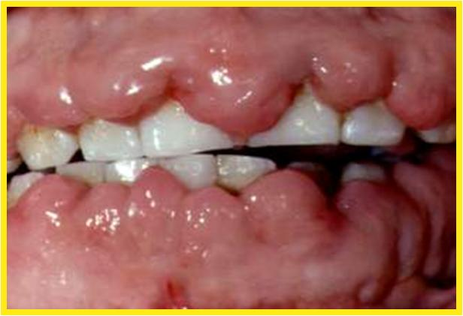

Slide 8
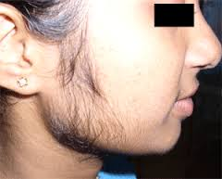

Slide 9
Carbamazepine
Membrane stabilizer
Related to tricyclic antidepressants
Extensively metabolized
t1/2 36 hrs on chronic dosage
Induces its own metabolism
Starting dose is 100mg daily

Slide 10
Carbamazepine - indications for use
Epilepsy
Trigeminal neuralgia
Post herpetic neuralgia
Manic depressive psychoses
Painful diabetic neuropathy

Slide 11
Carbamazepine - side effects
Rashes -Stevens-Jhonson syndrome
Visual disturbances
Leukopenia
Drowsiness

Slide 12
Ox carbamazepine
Similar to carbamazepine
Less side effects

Slide 13


Slide 14
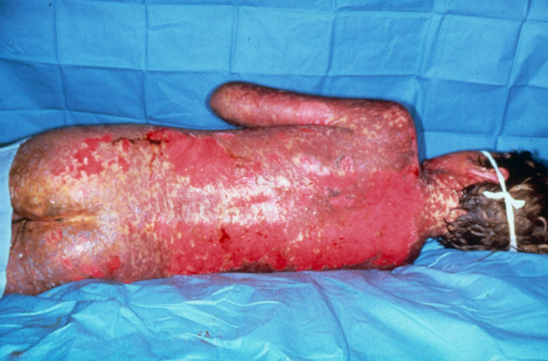

Slide 15
Sodium valproate
Inhibits GABA transaminase which breaks down GABA
Well absorbed
Highly protein bound
Mostly metabolised in the liver t1/2 12hrs

Slide 16
Sodium valproate-indications for use
Grandmal epilepsy
Myoclonic epilepsy
Absence seizures(petit mal)
Temporal lobe epilepsy

Slide 17
Sodium valproate- adverse effects
Gastrointestinal disturbances
thrombocytopenia
hair loss
impaired liver function tests
neural tube defects if prescribed in early pregnancy
drug interactions- inhibits the metabolism of other antiepileptics

Slide 18


Slide 19
Lamotrigine
used in grandmal epilepsy and partial epilepsy not responding to other medication
commonly causes a skin rash

Slide 20
Benzodiazepines
Clonazepam and clobazam
Myoclonic epilepsy and other resistent forms of epilepsies
Others too sedating for the routine use

Slide 21
Ethosuximide
Used in absence seizures
Side effects include gastric upset and eosinophilia

Slide 22
Paraldehyde
Used in status epilepticus
Given I.V or I.M

Slide 23
Newer antiepileptics
Vigabatrin
Topiramate-Also used in migraine
Gabapentine-Also used in neuropatheic pain/Fibromyalgia
Levetiracetam

Slide 24
Levetiracetam
Used in partial epilepsy in children and adults
Generalized tonic clonic seizures
Myoclonic seizures
Juvenile myoclonic epilepsy

Slide 25
General principles of therapy
When to initiate therapy- controversial
single commonly used relatively non toxic drug
monotherapy preferred
If one drug fails to completely control the fits -substitute of add another drug
abrupt withdrawal can precipitate status epilepticus
In most its possible to tail off drugs

Slide 26
Dosage
start with one third of the maintenance dose
increase weekly to reach the maintenance dose in 3 to 4 weeks
If fits continue dose should be adjusted upwards until the fits cease or adverse effects appear
2 equal daily doses preferable

Slide 27
Pregnancy and epilepsy
children born to mothers on therapy show increased rate of malformations at birth
withdrawl of antiepileptics even more dangerous
carbamazepine is preferred during pregnancy.
Folic acid is administered to reduce neural tube defects

Slide 28
Epilepsy in children
Treated like in adults
side effects more problamatic
Febrile convulsions managed with prophylactic diazepam

Slide 29
Status epilepticus
Continous fits or recurrent fits without regaining conciouness in between attacks
Lorazepam I.v, Clonazepam I.V
Diazepam I.V
Phenytoin I.V
Paralysis and ventilation

Slide 30
Drugs of choice in epileptic seizures
Gnand mal epilepsy (Tonic clonic)
sodium valproate,carbamazepine,phenytoin sodium,lamotrigene
Petit mal epilepsy(absence seizures)
Ethosuximide, sodium valproate
Partial seizures
carbamazepine,sodium valporate
Myoclonic epilepsy
clonazepam
sodium valproate

